Slide 1



DATA ANALYTICS
Shadi Shadab
April 2022

Slide 2
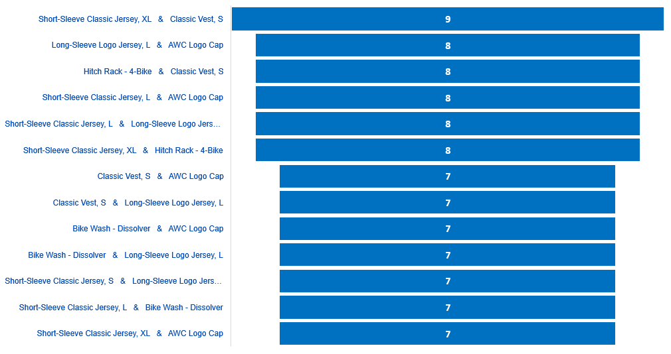
which products are usually sold together?
Product
association

Slide 3
Popular Products
which products are most popular?

Slide 4
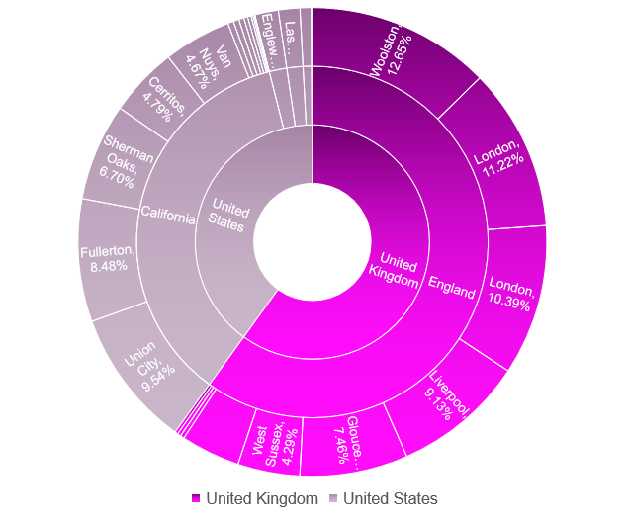
Geography
should we focus our sales effort in a specific area?
REVENUE
40.05%
59.95%

Slide 5
Dead products
do we have products that are rarely sold, and we should discontinue?

Slide 6
Customers
What are the customer’s characteristics and what shall we offer them?

Slide 7
Best Customers
Rewarding our best customers?
Customer Name | Purchase Amount | Purchase % | Purchase
Terry Eminhizer | 90341 | 12.65%
Krishna Sunkammurali | 80142 | 11.22%
Christopher Beck | 74160 | 10.39%
Kevin Liu | 68142 | 9.54%
Jon Grande | 65219 | 9.13%
Jeffrey Kurtz | 60525 | 8.48%
Rebecca Laszlo | 53249 | 7.46%
Anthony Chor | 47848 | 6.70%
Frank Campbell | 34209 | 4.79%
Catherine Abel | 33320 | 4.67%
Pamala Kotc | 29186 | 4.29%

Slide 8

What is the best rewards for best customer?
Offering special discounts
Loyalty card scheme & Free coupons
Free items with multiple purchases
Provide reciprocal discounts by partnering with a business
Let customers try out new products first
Event for reward introductions and referrals

Slide 9

THANK YOU!
+30 6940053692
Z.Shadabshoar@alba.acg.edu

